Slide 1
Exploration: documents and archives
Week 9

Slide 2
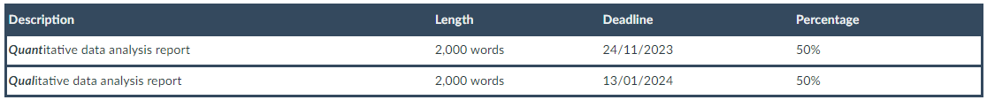
We’re nearing the end…
Assignment 2: Qualitative data analysis report
You will undertake a partial analysis of a qualitative dataset. The data is made publicly available for secondary analysis by the original authors via the UK Data Service or another online data repository. The data will be made available to you via Canvas.
A list of optional broad research questions to guide your analysis will also be made available. You can choose an analytic strategy that you see as most appropriate for the data and your research question.
Typically, you will analyse a body of text of around 10-15,000 words (e.g. five or six interview transcripts of around 2,000/2,500 words each), with the aim to identify themes and sub-themes in the narratives and interpret them in the context of your research question. You will write up your findings (interpretations) in a brief essay.
You should situate your research question and analysis within some existing academic literature on the topic. You will not need to do a full literature review, just to identify some of the most relevant sources. The essay should also include a brief reflection on the choices you made when analysing the texts (e.g. thematic coding decision), including how your own positionality might have impacted on your analysis.

Slide 3
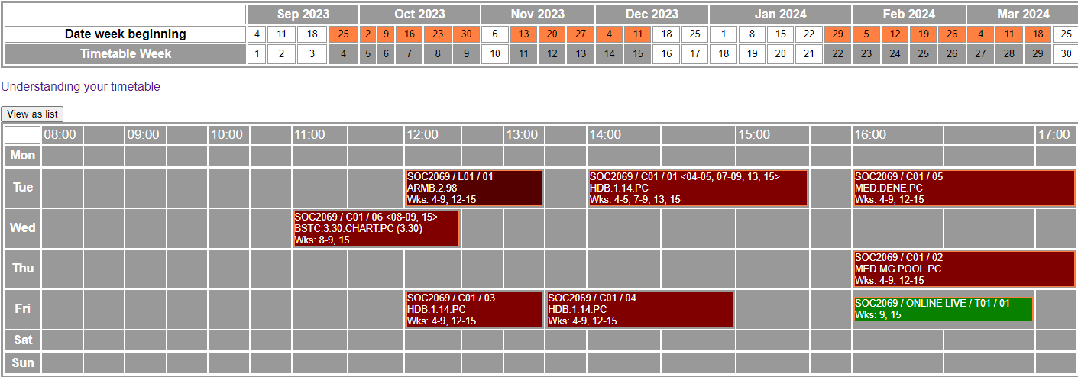
We’re nearing the end…
Assignment 2: Materials and Q&A drop-in session (online)

Slide 4
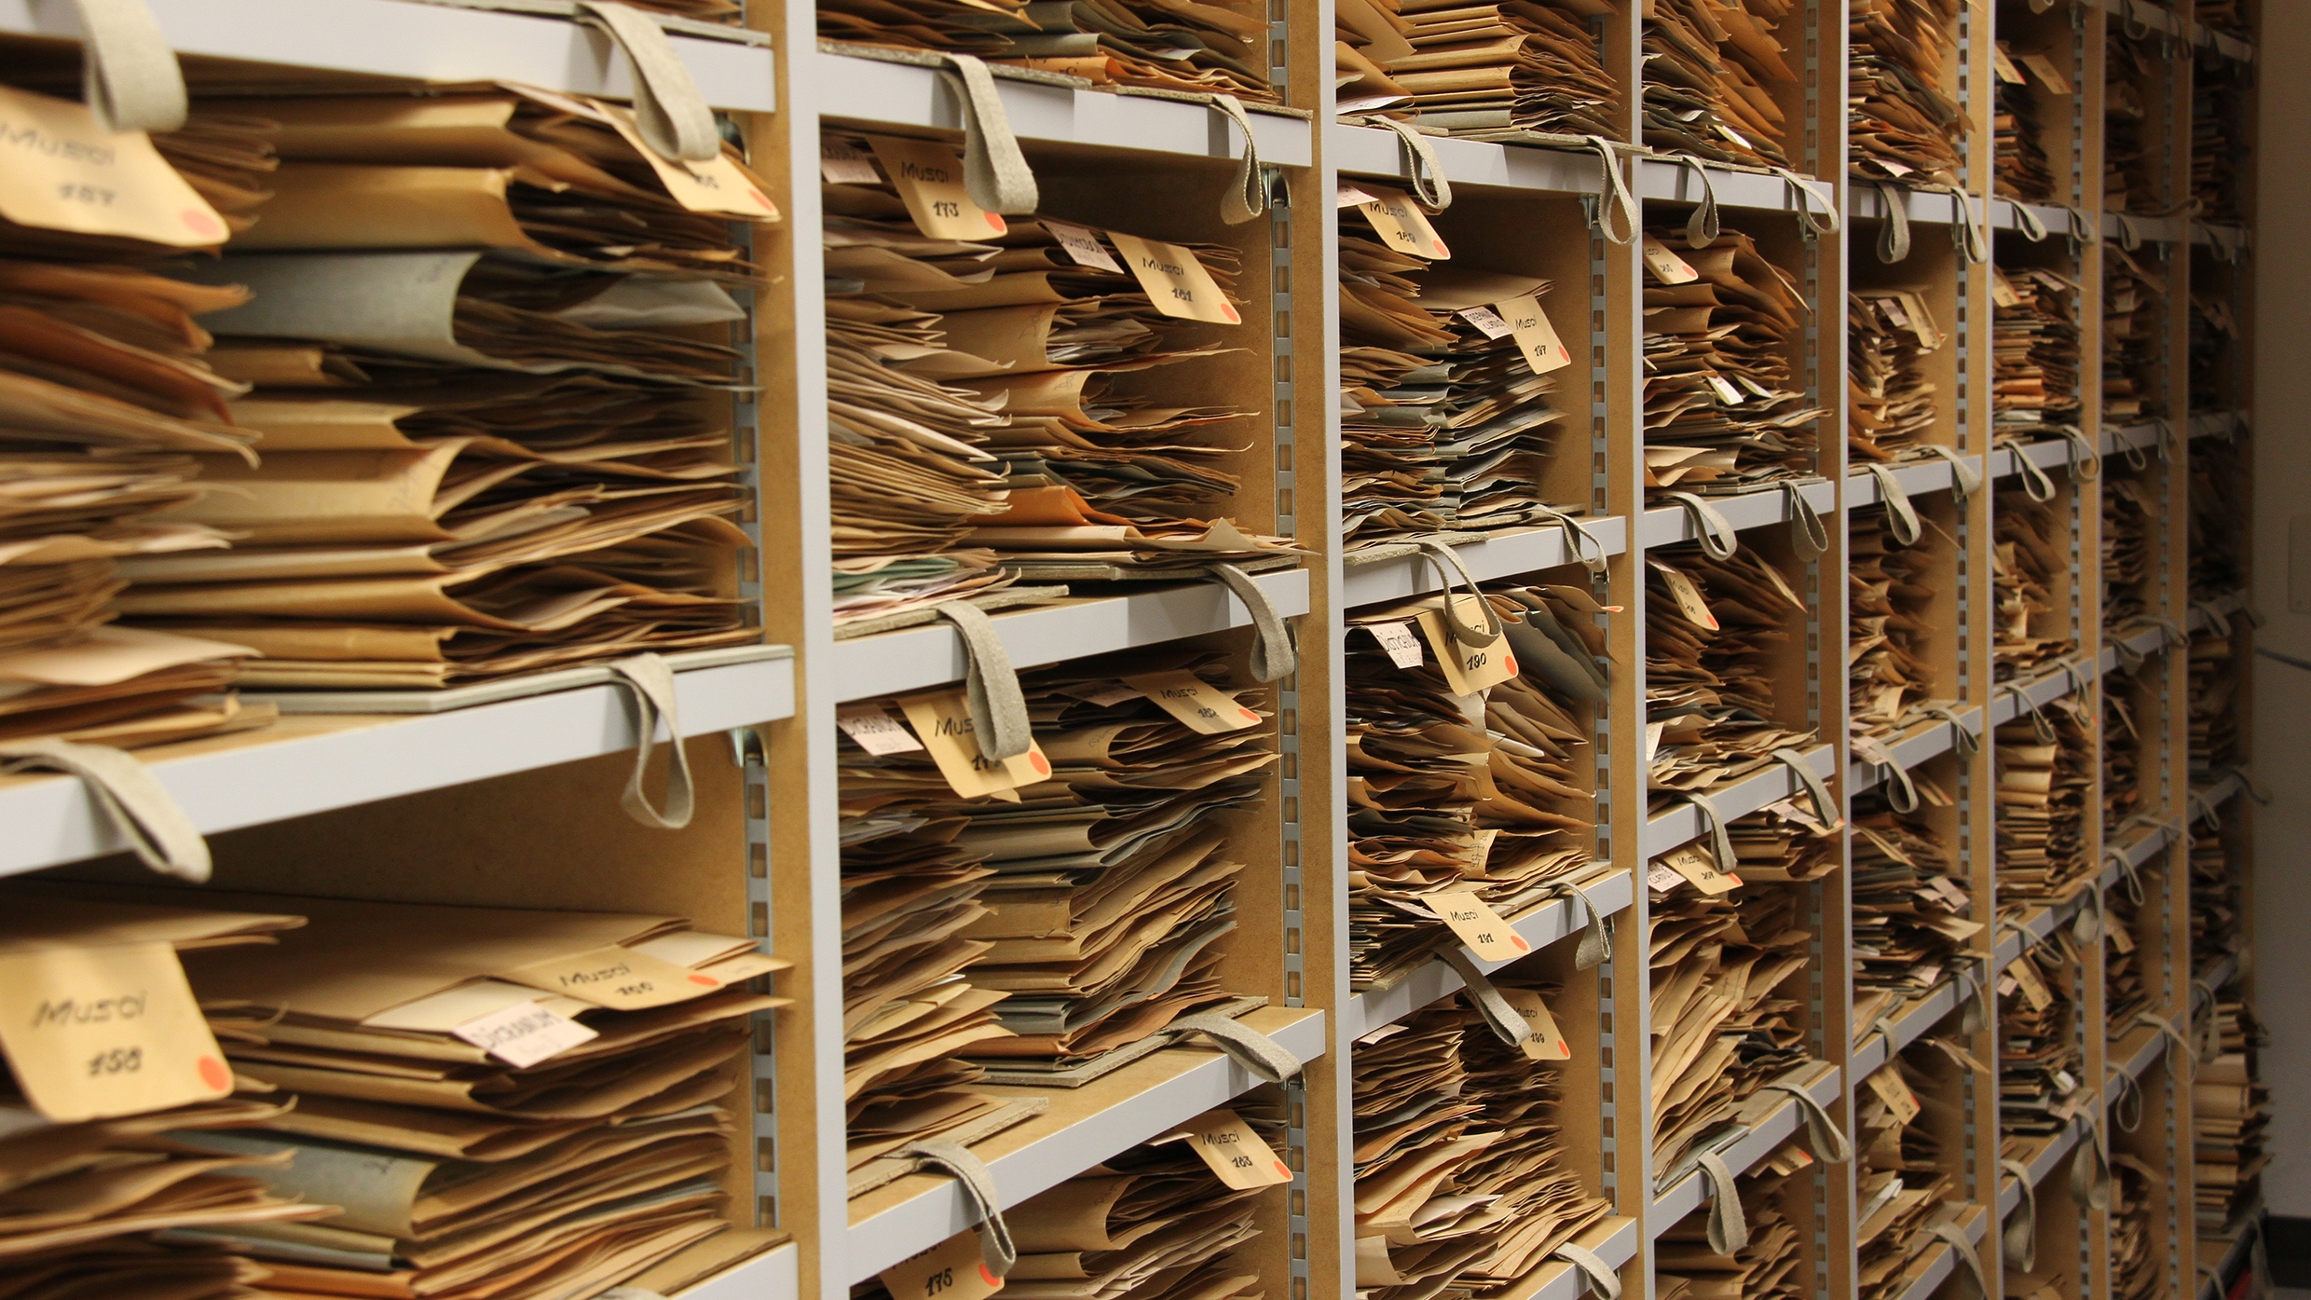
Documents and archives
Documents are ubiquitous in all societies with complex administrative apparatuses
Both physical, digital and digitalised
Increased ease of access
A great variety of original purposes (and therefore options for research questions)
Can you think of any “documents” you have produced, read or interacted with this week?

Slide 5
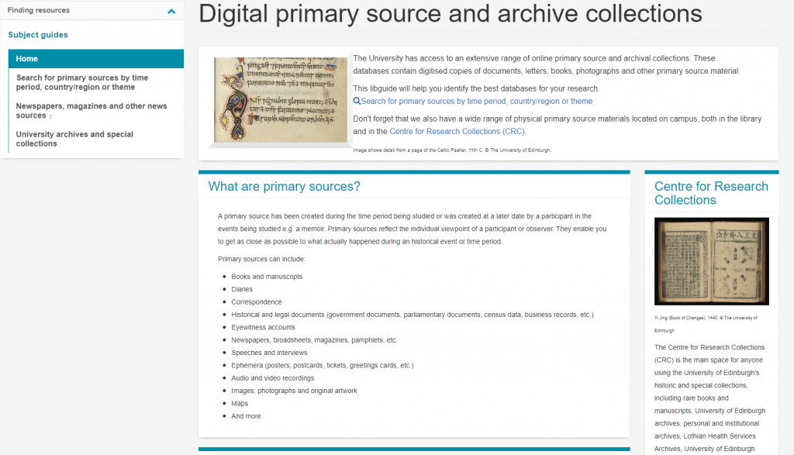
Exploring documents and archives

Slide 6
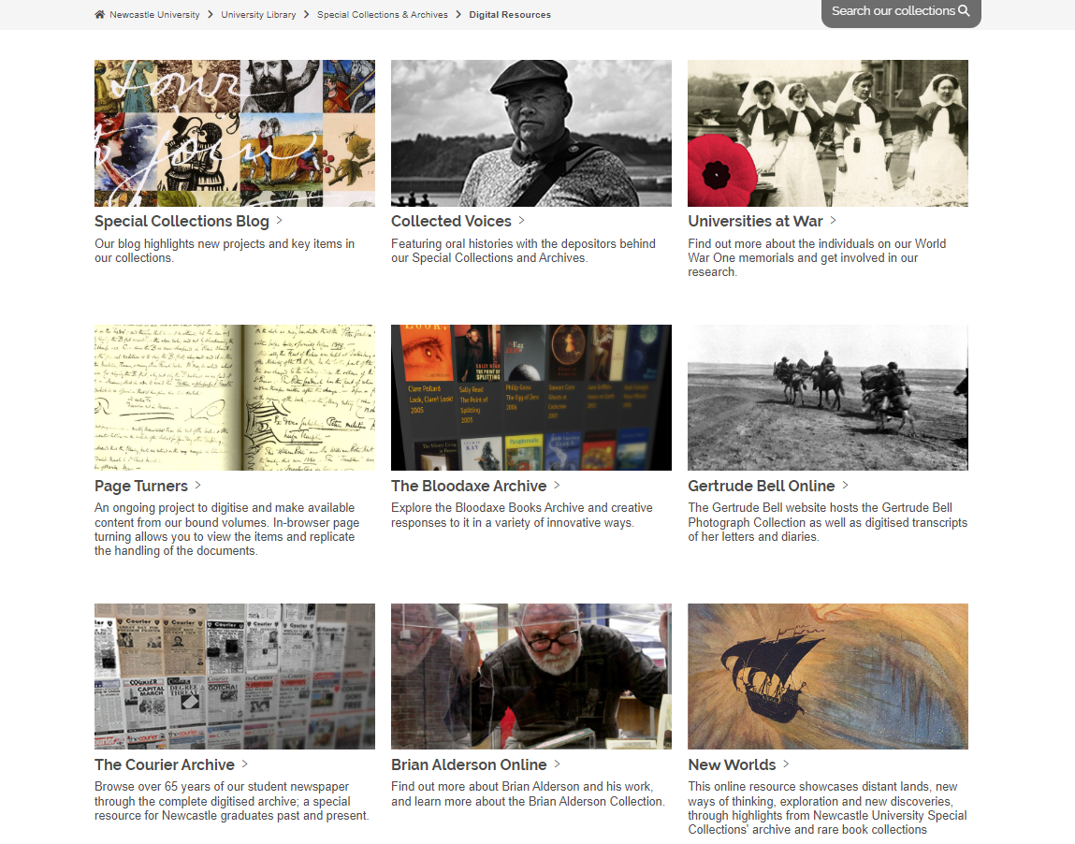
Exploring documents and archives

Slide 7
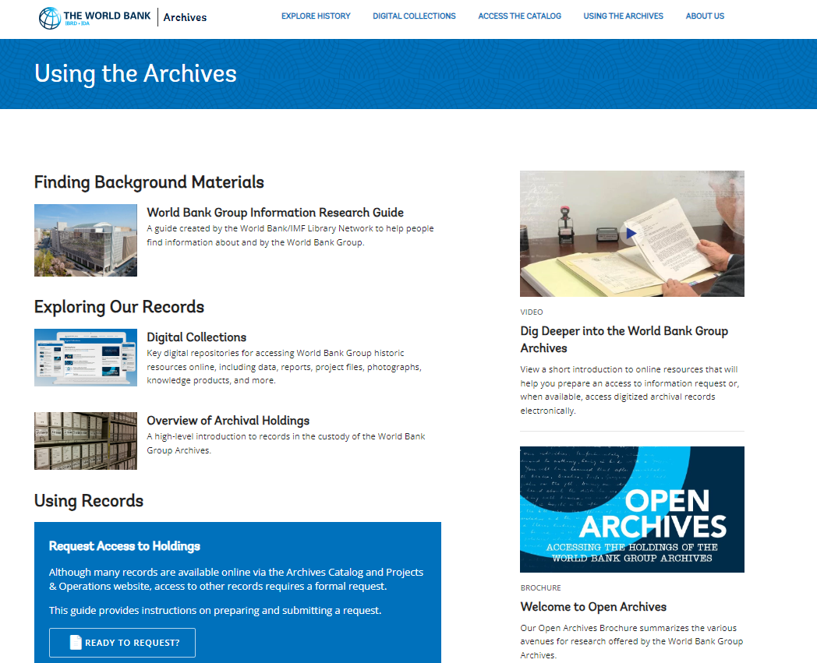
Exploring documents and archives

Slide 8
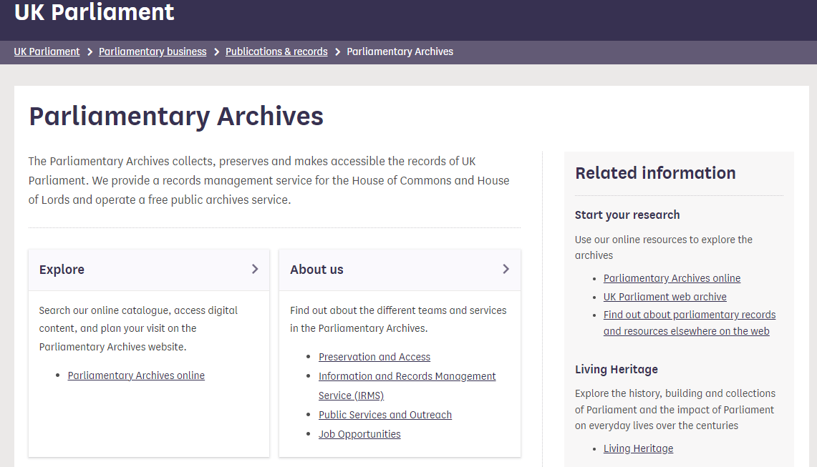
Exploring documents and archives

Slide 9
What is a “document”?
“a document in its most general sense is a written text” (Scott 1990)
“…content or objects which include written, graphical or pictorial matter, or a combination of these types of content, in order to transmit or store information or meaning” (Grant 2018)

Slide 10
What is a “document”?
Official legal documents
Party manifestos
Diaries
Content on a commercial website
Fliers, banners, adverts
“Tweets”, Tic-toc videos, YouTube videos
Post-it notes, scribbles, doodles
Anything else?
Can you think of any “documents” you have produced, read or interacted with this week?

Slide 11


Who “contribute” to a “document”?
Authors
Readers

Slide 12
Authorship and readership
Documents are a social construction (Thomas 1966)
Authors apply rules in order to meet social expectations and to jointly create knowledge with the (anticipated) reader(s)
Often there is not one single author of a document (teams, editors, proofreaders, etc.)
Essential to consider not only a document’s content but also the conditions under which the document was developed

Slide 13
Authorship and readership
Also important to consider the (anticipated, intended, unintended) readership to grasp the meaning behind documents and their biases
A document’s effect on a reader can vary significantly depending on their prior views, experiences, backgrounds, social/professional roles
A document can be seen as an “actor” in its own right, alongside the human “actors” (authors and readers) (cf. action-network theory; Latour 2005)

Slide 14
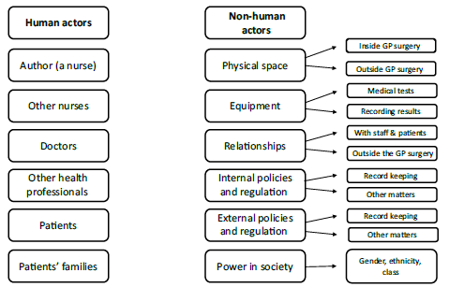
Documents as actors
Documents have the power to influence human agency because of the ways we use them in developed societies (Prior 2003)

Slide 15
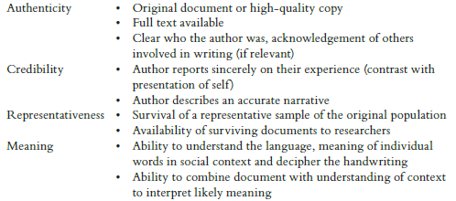
How then to assess documentary sources?

Slide 16
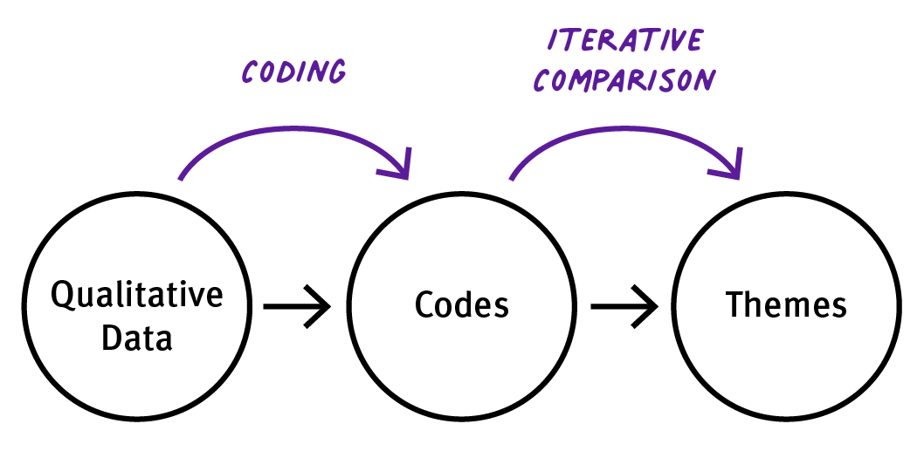
How to analyse documents?
Thematic analysis
a “method for identifying, analysing, and reporting patterns (themes) within data” (Braun and Clarke 2006, p. 6) in order to summarise issues across the data set (Green and Thorogood 2013).
The easiest approach as it is less challenging and prescriptive than other techniques, and can work with whichever theoretical perspective is important in your research, or indeed without a theoretical perspective
Inductive, deductive or both

Slide 17
How to analyse documents?
Framework analysis
Differs from thematic analysis in the additional step of taking extracts of data from particular codes and displaying them together in a matrix:
“tables created with headings and sub-headings from the coding framework, with a list of each data source forming the rows, to allow each individual piece of data to be viewed as a whole” (Grant 2018: 132)
A more thorough approach to analysis that makes it is harder to ignore data which do not follow a trend
Useful when the questions which the data need to answer are known in advance; this allows for the deductive construction of core high-level codes
but theories and themes can emerge from the data, allowing for inductive codes to be formed when necessary

Slide 18
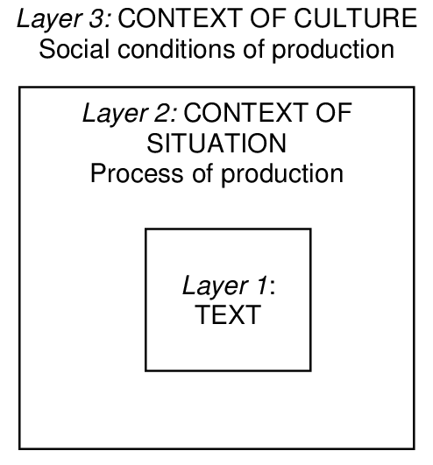
How to analyse documents?
(Critical) discourse analysis
“the study of social life, understood through analysis of language in its widest sense” (Shaw and Bailey 2009: 413).
A “spirit of sceptical readings” (Gill 2006: 216)
Premised on documents being powerful objects, with the power to create new – and reinforce existing – beliefs and ideologies within society (e.g. moral panics – gangs, immigration, etc.)
aims to highlight discourses within data in order to highlight and describe power relations, and to consider ways in which discourses that are negative for society can be challenged
Useful in order to reach beyond surface layer of meanings

Slide 19
A personal research example

Slide 20
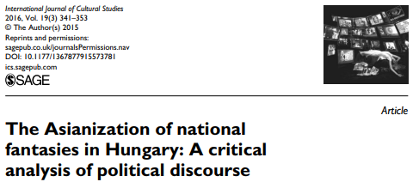
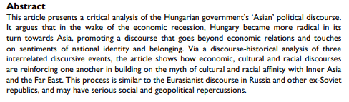
Moreh (2016)

Slide 21
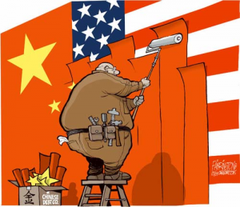
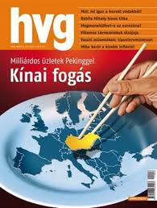
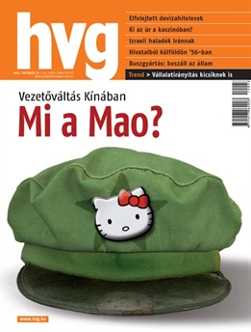
What ‘Asianisation’? Whose ‘Asianisation’?
Economic
Cultural
Regional
Demographic
Notes:
There are several interrelated ways in which Asianisation or the concept of an Asian century can be interpreted.
There is Asianisation in an economic sense – the meaning of which we all know, and as it became obvious in yesterdays sessions, money, economic power is fundamental for shaping ideas of home and new identities.
There is also a cultural sense of Asianisation - this can be seen as a combination of economic factors – like the production and dispersion of Asian cultural goods in the world – but also the reprodustion of local Asian cultural elements in diaspora communities – here culture reflects a deeper, anthropological meaning – living, foodways, holidays etc.
Connected to these is Asianisaton in the sense of an emergent identity, especially in South-East Asia. As we have heard yesterday, this is a very tricky question for Australia for example – Is Australia really in the right place at the right time in the Asian century? Can Australia move beyond an ecnomistic sense of belonging to Asia to a more identitarian one?
And of course there is another meaning to Asianization, present especially in Western countries like the US, Europe, and very prominently, in Australia – a demographic sense, a real fear about the Asianization of local population as a result of immigration.
In my paper I deal a bit with all these meanings, but especially with the idea of an Asian identity. And I deal not with the usual suspects, but with a Central European country, Hungary.
For Hungary, Asianisation could represent a new way of being in the Asian century, a new way of self-identification. I will talk about identity-construction not at the level of the individual or groups , but at the level of the nation and national politics.

Slide 22
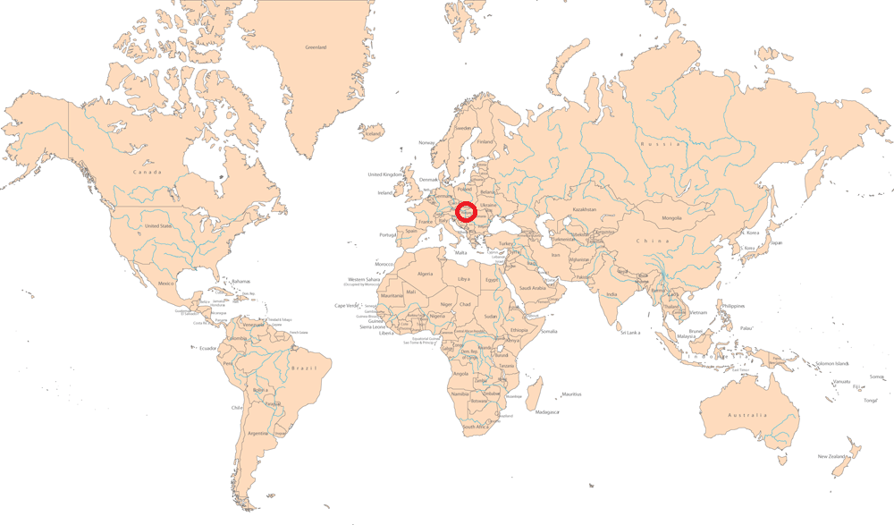
Notes:
Hungary is a rather small country in Central Europe, a new member of the European Union, bordering Austria to the West, Slovakia to the North, Ukraine and Romania to the East, and former Yugoslavian states to the South. For those who are not familiar with the region, these countries are all rather diverse in respect to their languages, ethnic groups and religions, and the states themselves are the result of the breakdown of the large regional empires in the 19th century, the Habsburg Empire, Tzarist Russia….
But I’ll get back to this period later
This is of course just one way of looking at the country.
For the most part of the 20th century it was located more to the right of the map …

Slide 23
Methodology
CDA, discourse-historical approach – (Wodak 2001)
‘discourse’ as ‘a complex bundle of simultaneous and sequential interrelated linguistic acts, which manifest themselves within and across the social fields of action as thematically interrelated semiotic, oral or written tokens’ (Wodak, 2001: 66).
Discourse – Context – Knowledge
Discursive events
“only those events can be seen as discursive events which are especially emphasized politically, that is as a general rule by the media, and as such events they influence the direction and quality of the discourse strand to which they belong to a greater or lesser extent” (Jäger 2001: 48)
Notes:
I will not talk too much about methodology since time is short. But briefly, I adopted a critical discourse analysis loosely modelled on the discourse historical approach.
The main aim was analysing discourse in a historical perspective and even a wider perspective of shared knowledge.
My procedure was identifying Discursive Events – Discursive evens have been characterised by Jager as being highly mediatised events, which therefore can shape the line of the entire discourse.
And Discourse, here, becomes a chain of thematically interrelated Discursive Events.
What I am focusing on in this paper are three major discursive events, which I identified as pertaining to three different categories of Asian discourse.

Slide 24
The Asian discourse
The ‘eastward opening’ – economic discourse
The ‘half-Asian nation’ – political and cultural discourse
The ‘red dot’ – ethnic and racial discourse
Notes:
I have separated them into three streams:
1 – is a general economic discourse that is familiar from other settings too. It is basically a realisation that the economic might of Asia – and more concretely China, cannot be overlooked any longer.
2 – the second event on the other hand alludes to the Asian provenience of the Hungarians
3 – and the third event is a stronger version, in which retained ethnic and racial traits are being emphasized.
For each I will show an excerpt from a speech, and will try to explain the background meaning – the context and the knowledge behind it.

Slide 25
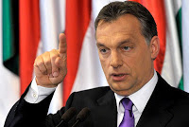
The ‘eastward opening’ I
“It does not result from this that anyone would want to reconsider the old, ancient Hungarian wish to be part of the western world, the western civilisation, that it is there where we want to fit in; it only means that this fact will appear from now on in a different system of relations than before. Figuratively, or simplistically speaking, we are sailing under western flag, but an eastern wind blows in the world economy. And the sailor, who does not take notice of the wind he should turn his sail according to, will probably doom himself and his cargo to wreck” (Viktor Orbán, 05 November 2010)
Notes:
The first event occurred soon after the 2010 elections, when the Prime Minister expressed his desire to change the foreign policy of the government to reflect more the changing economic realities.
The metaphor that was caught up in the media was the ‘eastern wind’ which soon became an ‘eastern opening’. An idea which truly terrified the socialist ad liberal opposition - although since then they are eagerly reminding that it was a socialist prime minister who first visited China in 2003 to establish relations. Back then, however, the European Union was the main direction.
Analysts have generally received the speech well, calling it a “realistic foreign policy”., which deals only with economic questions.
If we look at previous speeches, however, we can discover that the ‘economic discourse’ of the Prime Minister reaches a much deeper level than the purely economistic prospect.

Slide 26
The ‘eastward opening’ II.
“The situation is that as the consequence of the capitalist deformation of the past twenty-thirty years, regions other than Europe have emerged in a tempestuous pace, because they adhered to certain values. Such are China and India, and a few more. Europe has to face a situation in which it will return, so the western world, our civilisation will return on the economic map of the world, to the position it occupied one hundred and fifty years ago. (…) This is seemingly just an economic question, but I have never seen a restructuring in the world history – neither have I read of any – where a change in economic power relations of such a magnitude would not be followed by the political and military restructuring of the world. These are serious and critical issues. These need to be faced in honesty (Viktor Orbán, 24 July 2010)
Notes:
Couple of months earlier, for example, at a Summer University where the Prime Minister is a usual speaker, he presented his views on the rise of certain Asian countries, emphasizing “certain values” in their success. The demise of Europe therefore is seen as a consequence of a lack of real values.
And he also goes beyond economy when talking about the political and military restructuring of the world.

Slide 27
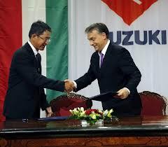
The ‘eastward opening’ III
“Our clothes are slightly dingy, we are a little more disorganised, we have let ourselves go a bit in the past eight years, there are signs of decadence here and there, but we believed in the values on which Your world is built, in honour, in diligence, in responsibility and in respect, and we can prove it. We, as members of the European Union, sail under western flag, but as You also know, we are an eastern nation, and for us, just as for You, the principal commandment is that every agreement has to be kept” (Viktor Orbán, 10 June 2010)
Notes:
Or, during the same summer, at the release of a new Suzuki model at the Hugarian factory, the Prime Minister addressed mister Suzuki with these worlds:
Here he details what exactly those values are.
And he uses the “western flag” metaphor again, but instead of the “western wind”, he talks about the “eastern origin of the Hungarian nation” as an excuse to being members of the European Union.
Seen intertextually, these speeches complement one another, and they are obviously addresses at different audiences.
This last speech also takes us further to a second strand of the Asian discourse, one emphasizing an Asian origin.

Slide 28
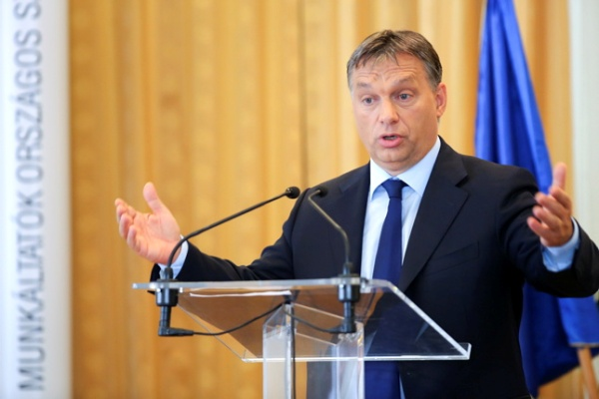
The ‘half-Asian nation’
“Since we are among ourselves: according to my philosophy and conception, being united is not a matter of will; being united is a matter of power [force]. The first condition of unification is power. If there is power, there is union. If there is no power, only faction, there isn’t any unification either. This might not be true for every culture; there might be countries where things do not work like this, say, at the Scandinavians, I could imagine. But at such half-Asian progenies like us, it is definitely the case”
(Viktor Orbán, 26 July 2012)
Notes:
The speech that became a true discursive event in this respect was delivered in July 2012 at a meeting at the National Association of Entrepreneurs and Employers.
Compared to the previous one, this speech is rather antagonistic. Here the Prime Minister links the concept of “power” or “force” – as a political leadership strategy – to the “half-Asian origin” of the Hungarians.
The speech caused an outcry in the liberal media, and reflects a vision of Asia which from a Western liberal democratic perspective is far from flattering.
It came, moreover, in the light of certain measures of the government, which could be seen as limiting the freedom of the press, and some other economic measures like the nationalisation of private pensionhouses.
The outrage was therefore caused not by the speech itself but in the light of autocratic policies.
Furthermore, the popularity of the idea of Asian origin had become so widespread during the previous two years, that the Prime Minister’s worlds have been read as authorising this previously unorthodox interpretation of historical material.
Here is where the background knowledge comes into the picture…

Slide 29
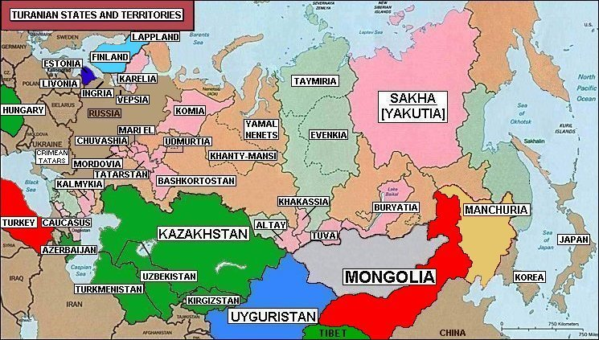
Notes:
The Asian origin of the Hungarians is usually formulated within the wider ideology of Turanism. Turanism emerged during the 19th century as part of Hungarian nationalism opposing the Habsburg rule. It rejected the linguistic theory of a Finno-Ugrian origin, in support of a Turkic allegiance. According to this view, linguistic resemblances between the Finnish and the Hungarian must be separated from ethnicity, and the Hungarian tribe must have come from deeper in Asia than assumed by Finno-Ugrian theory. Introduced as a linguistic concept, the term ‘Turan’ or ‘Turanian’ had soon reacquired its original geographical meaning, denoting the Central-Asian territories north of Iran, inhabited by nomadic tribes hostile to the Persians
By the end of the nineteenth century the search for the ancestral homeland had driven many explorers to Eastern countries, and several branches of Hungarian oriental studies have been shaped by the Turanian vision. In popular conceptions the Turan stretched to include all the territories supposedly inhabited by kin-nations. In the strictest usage, it referred to Altaic-Uralian peoples like the Finns, Estonians, Turks, Mongols, Japanese or Koreans. More inclusive definitions incorporated the Chinese, the Tibetans and the Indians, and according to the most extreme vision, such ancient empires as the Sumerian, Aryan, Iranian, Scythian, Hittite, Assyrian or Etruscan (Paksa 2012: 33). It has been suggested that this sense of kinship is still alive in many Asian countries, being one of the few things that Japanese or Korean ‘average intellectuals’ mention when asked about Hungary (Osváth n.d.). The Chinese denomination Xiongyali is also supposed to share the same root with xiongnu, referring to an “Asian Hun nation” (Szunomár 2011: 388), and according to Tálas (2008a), at the turn of the twentieth century,
there was a widespread belief in China that the Hungarians, of Inner Asian origin and whose ancestors had been living on the East-Western borderlands of today’s China at the feet of the Altai and Tien Shan mountains some two thousand years ago, during the Han dynasty, are in fact the westernmost located and most civilised representatives of the ‘yellow race’ (2008a: 200).
In the first half of the past century Turanism became part of the extreme right’s official ideology, falling into disrepute after the Second World War. During communism it was rejected and demonised as a Nazi ideology, being eliminated from popular knowledge. It was only after the fall of Communism that elements of the Turanic thought have been revived in certain extreme-right circles, remaining, nevertheless, voiceless in mainstream politics and the academia (Paksa 2012).
Since the great political success of the extreme-right Jobbik, the position of Turanism seems to be changing, and Turanists are able to make their voices heard more widely

Slide 30
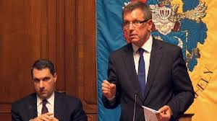
The ‘red dot’
“We are proud of having come from Asia. On the bottom of our infants, in about thirty out of one hundred cases, for six weeks there is a small red dot, just like in the case of Japanese babies. I have been told about this by Japanese scientists, I didn’t know before. (…) My point in mentioning this is just that sometimes others know more about us than ourselves. While talking with Chinese delegations many times a week, they all begin their talks saying that, well yes, between us there is some deep, deep, deep…
maybe even kinship”
(György Matolcsy, 16 November 2012)
Notes:
It was following these events that a speech by the National Economy minister was turned into a discursive event.
The minister reacted to a question from the audience with this humorous – but serious response. Obviously he was inaccurately referring to the Mongolian spot, widespread in many Asian and south-American populations.
What is truly meaningful is not the discursive event itself, but what lies behind it – a widespread belief in the Asian ethnic origin.
Something that had been a rejected ideology in the past has found its way into mainstream political discourse and could deeply change the national self-identification of the Hungarians.

